Slide 1
Microsoft Licensing Update – UK Schools
Paul Harris
Microsoft Education
@paulnharris

Slide 2

Microsoft VL update
Office 365 Education update
Q&A
  Agenda

Slide 3
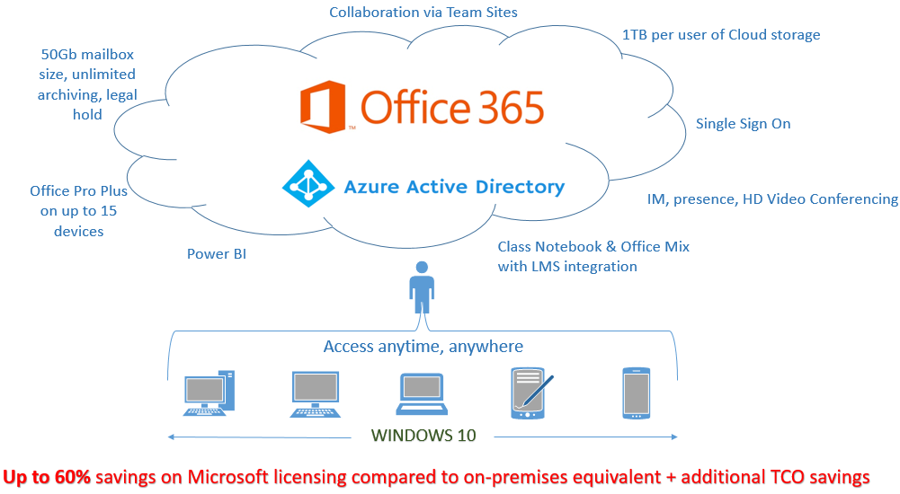
Education Cloud Transition
Other support
(SME services including helpdesk)
Disruption of the status quo to provide:
TCO savings via removal of Servers
Public Cloud provision of services and software
Full Office suite for all Staff and Students
Huge Storage – Email, Files, Video etc
Enterprise class security & accreditation
Server licensing, hardware, management, deployment and storage costs
Services can be provided from public cloud
Other support
(SME services including helpdesk)
Office Pro
Office 365 Education + Windows 10 Education + EMS
Software licensed through OVS-ES or EES
Core CAL
Windows Upg.
Hardware incl Windows
Hardware incl Windows

Slide 4
Transition period by program – OVS-ES & EES
CUSTOMERS TRANSITION TO CLOUD
Renewing UK School customers
1st July 2016
1st January 2016
1st July 2018
MOU 2013 Discounts minus 3 yr desktop discount
Price Change
OVS-ES/EES
Expiring subs customers sign 1 or 3 year EES/OVS-ES with comparable MOU 2013 discounts. No 3 year desktop discount
Expiring subscription customers sign EES/OVS-ES at harmonised price/Cloud
New UK School customers
1st January 2016
1st July 2016
1st July 2017
1st July 2018
MOU 2013 Discounts minus 3 yr desktop discount
Price Change
Price Change
Price Change
OVS-ES/EES
New subscription customers sign EES/OVS-ES with comparable MOU 2013 discounts, locked for up to 3 years. 3 year desktop Platform Discount removed.
New subscription customers sign discounted EES/OVS-ES
New subscription customers sign EES/OVS-ES at harmonised price/Cloud

Slide 5
Transition period by program – Academic Select Plus
CUSTOMERS TRANSITION TO CLOUD
UK Schools
1st Jan 2016
1st July 2016
1st July 2017
Academic
Select Plus
New Select Plus orders maintain MOU 2013 Discounts
Select Plus discounts reduced
Select Plus discounts removed

Slide 6
Transition period by program – School Agreement
CUSTOMERS TRANSITION TO CLOUD
1st Jan 2016
1st July 2016
1st July 2017
School
Agreement
New/expiring School Agreement customers sign 3 year School agreement with reduced discounts or move into OVS-ES/Cloud*
New/expiring School Agreement customers sign 3 year School Agreement with reduced discounts or move into OVS-ES/Cloud
New/expiring customers sign School Agreement with MOU 2013 Discounts, locked for up to 3 years
*Expiring School agreement customers may sign new OVS-ES enrolment at ‘renewing’’ prices

Slide 7
Special Terms (UK Schools Only)
UK Licensing concessions (Schools only)
  Defining Institution
  True down at anniversary
  OVS-ES/EES buyout @ 10% discount
  School agreement customers may start a new OVS-ES/EES at ‘renewing customer’ discounts

Slide 8
Education Cloud Transition
Other support
(SME services including helpdesk)
1
Migrate to the cloud
Server licensing, hardware, management, deployment and storage costs
EMS
Add-On
Other support
(SME services including helpdesk)
Azure Active Directory
Reduce mgmt. costs through Active Dir in the cloud and device mgmt. through Intune
Office 365 Education + Windows 10 Education + EMS
O365 Education
Provide identity/access through Cloud
Office Pro
Old stack
Reduce storage costs and migrate email and docs to the cloud
Core CAL
Windows Upg.
Hardware incl Windows
2
Further extend the migration time by renewing
old stack during the transition period
Hardware incl Windows

Slide 9
Questions so far
What are/were the benefits / differences for each of the ‘traditional’ licensing schemes?
In the context of the push to move people to cloud delivered services, how do we migrate licensing to the cloud equivalent without ‘double paying’ for capabilities?
How to we ‘add’ cloud capabilities to the traditional licences?
How do we add on-prem capabilities if we are primarily Cloud customers?
How do we do this without significantly increasing cost?
Scenario
Consider a large school on EES-OVS, with fully virtualised servers, licensed for Office ProPlus (with student and Teacher add-ons), SCCM, Exchange, Enterprise CALs, Software Assurance (specifically MDOP) a few instances Server DataCenter, and SQL Server and System Centre with InTune add-on, and an Office 365 instance.
Given the on-prem capabilities, to get equivalent in the cloud it appears that one would need to licence the Enterprise Mobility Suite. This is a substantial addition cost. Making a case for paying for what Senior Managers perceive to be free, or not ‘core business’ activities, is a tough sell.
How does the school move to the cloud without substantial additional cost, or loss of capabilities?

Slide 10
License Mobility & Cloud Workloads
SA customers can deploy owned licenses on the cloud
STB Products with License Mobility
SQL Server
BizTalk Server
Team Foundation Server
Sharepoint Server
System Center Server
STB Products with SA Cloud Usage Rights
Remote Desktop Services
STB Products without License Mobility
Windows Server
Designed to simplify the move to the cloud, License Mobility enables customers with active Software Assurance to deploy licensed software to a third party’s shared servers.
For more: http://www.microsoft.com/licensing/software-assurance/license-mobility.aspx

Slide 11
Introducing the Azure Hybrid Use Benefit
What is Azure Hybrid Use Benefit (HUB)?
An Azure benefit that enables customers with SA-covered Windows Server licenses to pay base compute pricing* when they upload and run their self-built Windows Server images on Azure
Additional value to your Software Assurance investment
Azure HUB enables more cost-effective Windows Server deployments on Azure
Azure HUB offers fantastic customer value for Standard and Datacenter editions
*Non-Windows (Linux) pricing

Slide 12
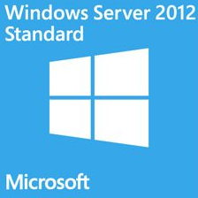
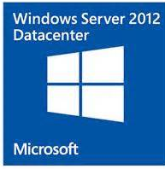
Azure HUB Licensing Benefit
customer’s On-Premise License | Windows server Azure enablement | License impact for customer
 | Customers with Windows Server SA are entitled to: Two instances of 1 to 8 cores or One instance of up to 16 cores Stack licenses for VMs larger than 16 cores | Customer’s Window Server license cannot be assigned to other hardware while Azure HUB is being used
 |  | Customer’s Windows Server license can continue to be assigned both on premise and in an Azure environment
Two-Proc
Two-Proc
Examples for 1 Windows Server License
Virtual Machine #1 | Virtual Machine #2
D14 (16 vCore) | N/A
D13 (8 vCore) | D13 (8 vCore)
D2 (2 vCore) | D2 (2 vCore)
Examples for 2 Windows Server Licenses (Stacking 2 Licenses)
Virtual Machine #1 | Virtual Machine #2 | Virtual Machine #3 | Virtual Machine #4
G5 (32 vCore) | N/A | N/A | N/A
D14 (16 vCore) | D14 (16 vCore) | N/A | N/A
D13 (8 vCore) | D13 (8 vCore) | D13 (8 vCore) | D13 (8 vCore)
D2 (2 vCore) | D2 (2 vCore) | D1 (1 vCore) | D1 (1 vCore)

Slide 13


Azure HUB Customer Savings: Example 1
Scenario
Customer has a single Virtual Machine and is interested in taking advantage of Azure HUB
Annual Cost for a single Azure D2 VM*
£1,238.00
Azure HUB offers the customer
40% in annual savings
Win Svr Std £35.00
Annual Cost for
Base Compute pricing*
£700.00
*Estimated per annum, 744 hours

Slide 14
Azure HUB Customer Savings: Example 2
Scenario
  Customer has 20 Windows Server Standard Edition licenses that are all covered with Software Assurance
  Customer wants to move 10 of these to Azure and have a total of 20 D3 Windows instances in the Cloud
On premises
Cloud
10 Windows Server Standard Edition w/ SA
20 D3 Virtual Machines in the Cloud
Scenario | Current: 20 Windows Server SE licenses with SA Objective: Apply 10 WS SE licenses to Azure HUB
Cost of 20 WS D3 VM’s w/o Azure HUB | 20 x £2,476.00 = £49,520.00
Cost of 20 WS D3 VM’s with Azure HUB | 20 x £1,410.00 (Base Compute pricing) = £28,200.00 Plus 10 x £35 (WS SE with SA) = £350.00 Total is £28,550.00
Annual Savings with Azure HUB | £20,970.00 = 42% in annual savings
Customer Actions | 10 WS SE licenses must be shelved (now assigned to Azure as part of Azure HUB) 10 WS SE licenses remain to be used on premises

Slide 15
Questions so far
Using Cloud productivity suite services is still not a slick / free from friction as the ‘legacy’ desktop app approach, with shared folders and network home directories. Until it is, scenarios where "cloud first” is the right solution will remain edge cases (for example 1:1 device deployments). Discuss.
Is licensing after 2018 going to be based on FTE staff like it is now?
What is the price difference actually going to be on renewal of licensing after 2018? In terms of cost per FTE?
Is Education discount going to completely disappear or is it just the additional discounts UK schools enjoy that will disappear?
Is Office 365 going to continue to be free after 2018?
Will this affect all licensing such as server / client licensing and office?
Have Microsoft got any confirmed Education pricing for Azure?

Slide 16
Office 365 Education UPDATE
April 2016

Slide 17
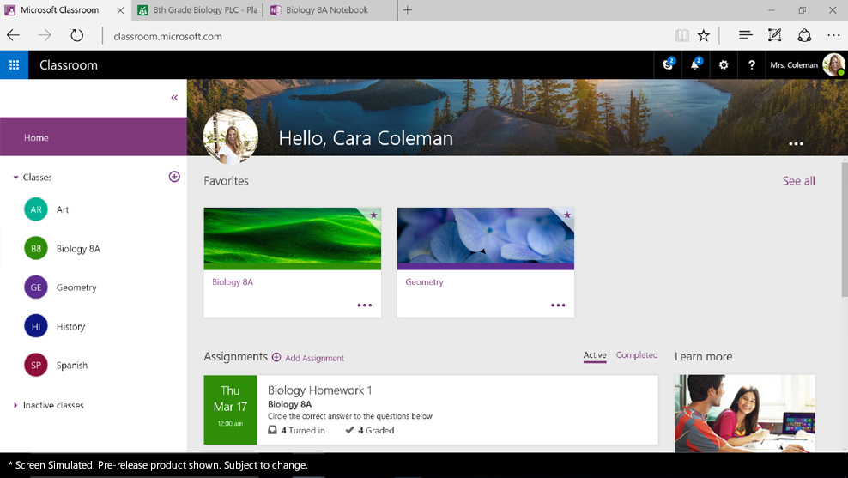
Microsoft Classroom
http://fasttrack.microsoft.com/roadmap
Single experience for managing all classes and assignment workflow—with a teacher and student view.
Students can receive, complete and submit assignments on their favourite devices, including mobile devices via the Microsoft Classroom app
collaborate with classmates in real time within Office documents, online or offline, without worrying about losing formatting
Coming to the UK Soon - Any teacher can start a Class Notebook for free now by going to onenote.com/classnotebook

Slide 18
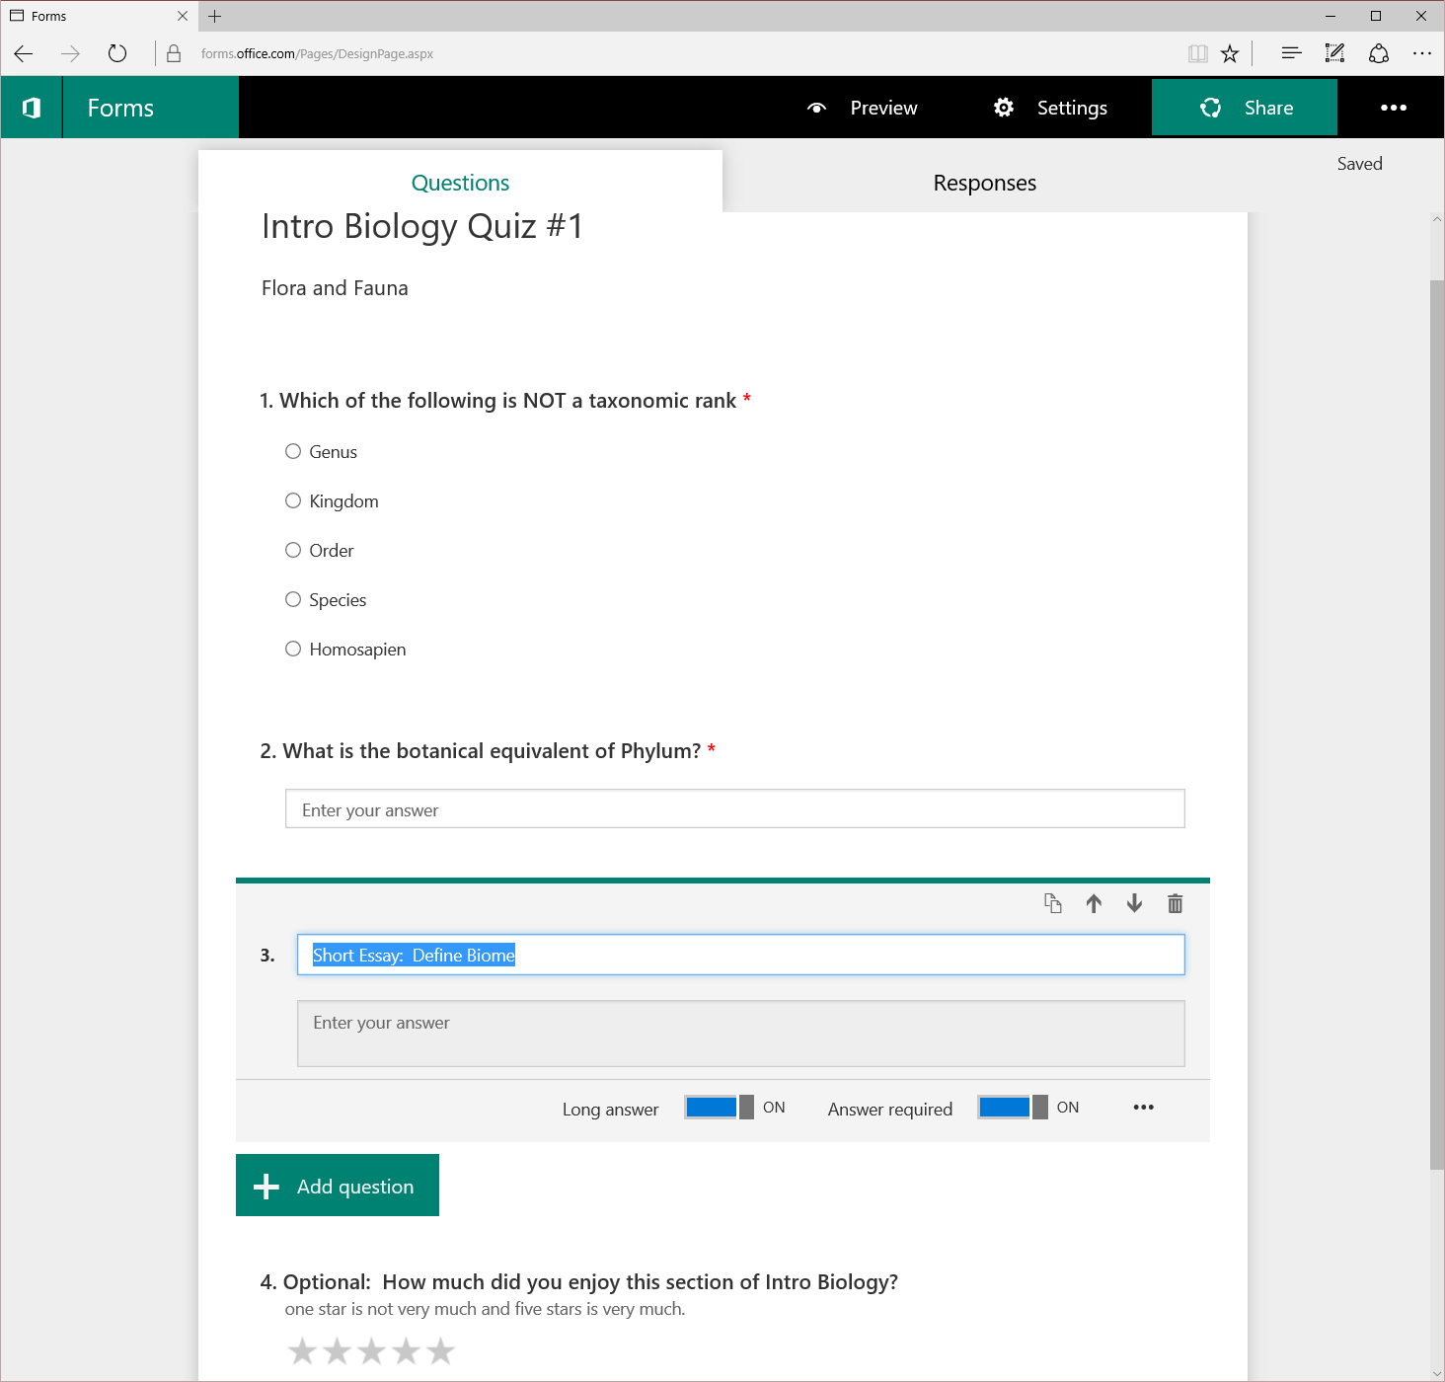
Microsoft Forms
http://fasttrack.microsoft.com/roadmap
Quickly assess student progress and get feedback with easy-to-create surveys, registrations, quizzes and more
Form authors can invite others to complete forms, which they can do using any web browser, even on mobile devices.
Form authors can view results as they are submitted using the built-in analytics
Forms data (i.e., quiz results) can be easily exported to Excel for additional analysis or grading.
https://forms.office.com/

Slide 19

School Data Sync
http://fasttrack.microsoft.com/roadmap
Sync user profiles and class rosters from your Student Information System
Provision groups and class websites
Allow learning apps to securely access student data.
https://sds.microsoft.com/

Slide 20
OFFICE 365 EDUCATION OFFERINGS
 |  | EDUCATION | EDUCATION E5
 | Features Office 365 Services | Free | 1st May 2016
 | Business Class Email and Calendars Exchange Online | Unlimited | Unlimited
 | Social, Video, Sites, Work Management Yammer, O365 Video, SharePoint Online, Planner | New ● | ●
 | IM, Online Meetings Skype for Business | New ● | ●
 | File Storage, Sharing, Information Discovery OneDrive for Business, Delve | ● | ●
 | Office Online | ● | ●
 | Office Client Apps Office 365 ProPlus | ● | ●
 | Archiving, Rights Management, Data Loss Prevention, Encryption | New ● | ●
 | Office 365 Advanced eDiscovery, Secure Attachments and URLs, Access Control |  | ●
 | End User and Organizational Analytics Power BI Pro, Delve Analytics |  | ●
 | Cloud PBX Skype for Business |  | ●
 | PSTN Conferencing* Skype for Business |  | ●
 | Enterprise Plan Add-ons
 | PSTN Calling Skype for Business |  | +TBC
*Toll-free and International Dial-out conferencing capabilities will incur additional per minute consumption charges when available. Customers can disable this feature to avoid additional billing.

Slide 21
E5 - BUILT FOR TEAMS AND NETWORKS
PSTN CONFERENCING
Use a dial-in number to join Skype meetings from any device
Dial-out to bring participants into the meeting
CLOUD PBX
  Office 365 as the central location to manage users for communications, email and content
Eliminate separate PBX systems and transition to the cloud
PSTN CALLING
Subscribe to calling plans from Office 365
Use existing phone numbers or get new ones

Slide 22

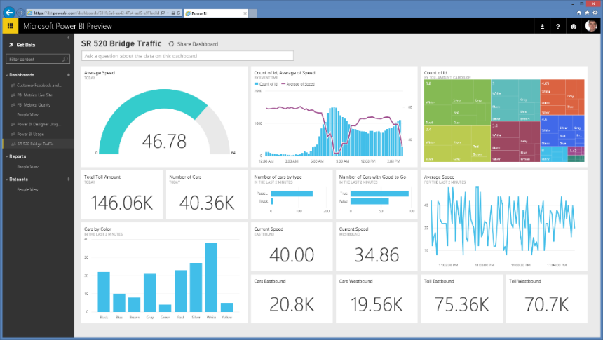
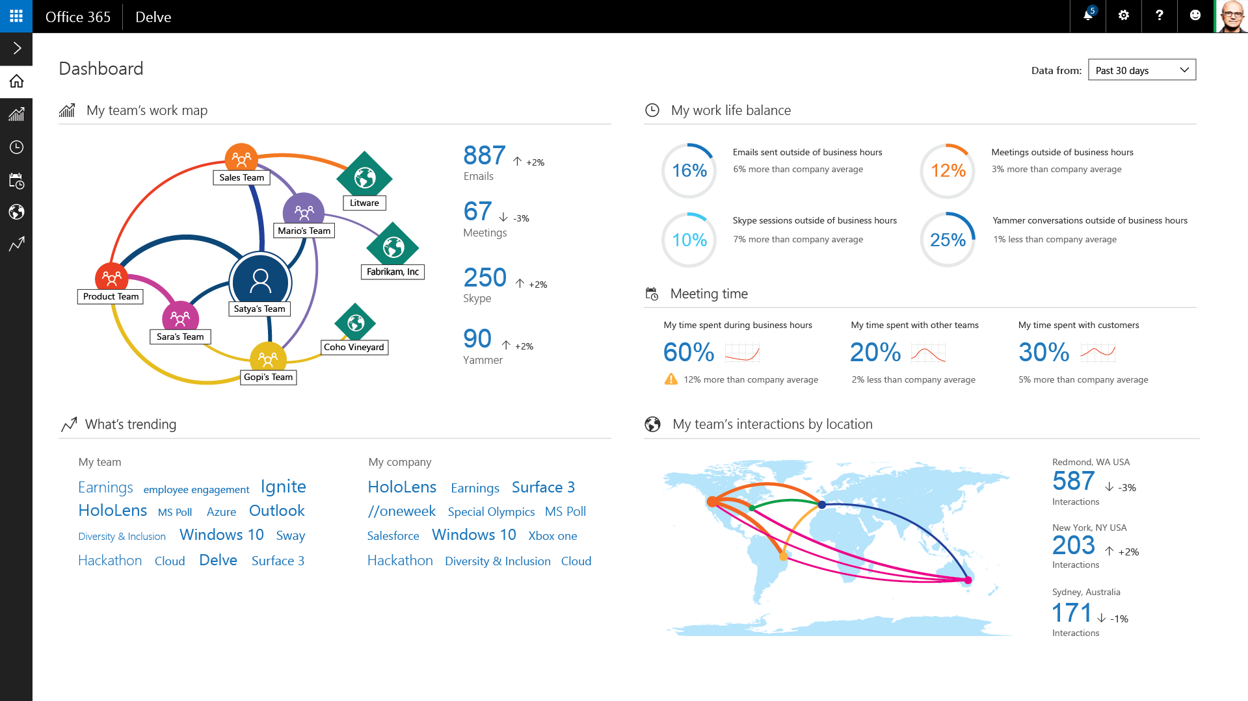
E5 - PERSONALISED AND ORG INSIGHT
POWER BI PRO
Fast, easy access to the data you need
One dashboard, a live 360º view of your business
Explore your data and discover new insights
POWER BI PRO
DELVE ANALYTICS
Real-time work map of team engagement
Surface trending topics & interaction around those topics
DELVE ANALYTICS

Slide 23
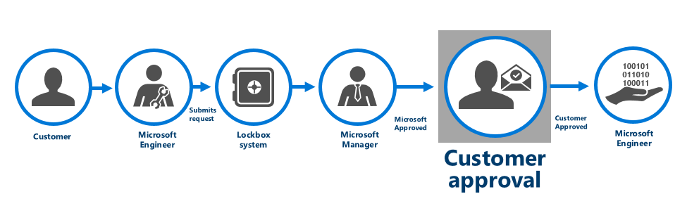
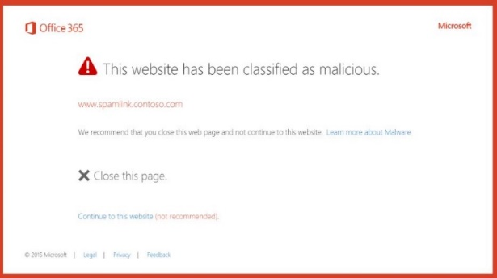
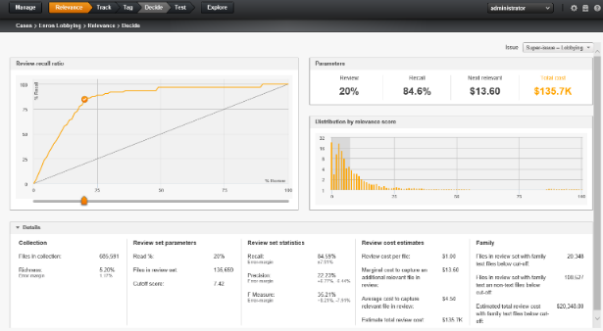
E5 - PEOPLE CENTRIC COMPLIANCE
CUSTOMER LOCKBOX
Customer explicitly controls all access to data
Nearly zero Microsoft interaction with customer content
All access control activities logged and audited
CUSTOMER LOCKBOX
ADVANCED THREAT PROTECTION
Protection against unknown malware and viruses
Real time, time-of-click protection against malicious URLs
Rich reporting and URL trace capabilities with Click Tracing
SECURED ATTACHMENTS/URLS
OFFICE 365 ADVANCED eDISCOVERY
  Email review simplified by detection analytics
  Predictive coding trains system to identify relevance
  Themes and Search help map unstructured data
OFFICE 365 ADVANCED eDISCOVERY

Slide 24
OFFICE 365 EDUCATION OFFERINGS (ERP)
(STUDENTS AT 25% DISCOUNT VS FACULTY)
 |  | EDUCATION | EDUCATION E5
 | Features Office 365 Services | Free | £5.78 Faculty PCM £4.41 Student PCM
 | Business Class Email and Calendars Exchange Online | Unlimited | Unlimited
 | Social, Video, Sites, Work Management Yammer, O365 Video, SharePoint Online, Planner | New ● | ●
 | IM, Online Meetings Skype for Business | New ● | ●
 | File Storage, Sharing, Information Discovery OneDrive for Business, Delve | ● | ●
 | Office Online | ● | ●
 | Office Client Apps Office 365 ProPlus | ● | ●
 | Archiving, Rights Management, Data Loss Prevention, Encryption | New ● | ●
 | Office 365 Advanced eDiscovery, Secure Attachments and URLs, Access Control |  | ●
 | End User and Organizational Analytics Power BI Pro, Delve Analytics |  | ●
 | Cloud PBX Skype for Business |  | ●
 | PSTN Conferencing* Skype for Business |  | ●
 | Enterprise Plan Add-ons
 | PSTN Calling Skype for Business |  | +TBC
*Toll-free and International Dial-out conferencing capabilities will incur additional per minute consumption charges when available. Customers can disable this feature to avoid additional billing.

Slide 25
Education E5 Component Standalones & Add-Ons
Office 365 E5 and Component Pricing (per month ERP) | Faculty | Student
Office 365 Education E5* | £5.78 | £4.41
Office 365 Education E5 Addon to CoreCAL/ECAL with Office Pro Plus* | £4.08 | £3.58
Office 365 ProPlus | £1.69/Free** | £1.27/Free**
Project Pro for Office 365 | £1.38 | £0.68
Visio Pro for Office 365 | £1.38 | £1.03
Advanced Threat Protection* | £0.87 | £0.44
Customer Lockbox* | £0.46 | £0.35
Delve Analytics* | £0.94 | £0.69
Power BI Pro | £1.31 | £0.73
Office 365 Advanced eDiscovery* | £1.87 | £1.40
Cloud PBX* | £1.87 | £1.40
PSTN Conferencing* | £0.94 | £0.70
 | International | Domestic
PSTN Calling | £TBC | £TBC
*New EDU SKUs
** Free benefit for Institutions licensed for all FTE for Office Pro Plus under EES and OVS-ES.

Slide 26

E5 HELPS EDUCATION CUSTOMERS SAVE ON COSTS
Current EES/OVS-ES Desktop Edu Customers
£8.26
EDUCATION PER USER
STANDALONES (Faculty)
Cloud PBX
£1.87
PSTN Conferencing
£0.94
Office 365 Advanced eDiscovery
£1.87
Advanced Threat Protection
£0.87
Customer LockBox
£0.46
Delve Analytics
£0.94
£4.08
EDUCATION PER USER SUITE PRICE (Faculty Add-on to CoreCAL/ECAL + Office Pro Plus)
Power BI
£1.31
Office 365 ProPlus
FREE*
Office 365 Education
(SharePoint Online, Exchange Online,
Skype for Business, & Yammer)
FREE
Office 365 Education E5
** Free benefit for Institutions licensed for all FTE for Office Pro Plus under EES and OVS-ES.

Slide 27
Q&A

